Slide 1
Bounding box Side = 2 * max incident length + longest connection length
1 Minimum length of a edge = ½ (combined bounding box’s side)
2. No overlap of bounding boxes
3. Number of incident roads

Slide 3
Add new intersection
Add new T-intersection
Create a network
Random
Urban residential style
Downtown style
Old style
x
x
x
Export to Opendrive

Slide 4
User input plans
n-way intersections (n[3,5])
Number of intersections
Overall shape? (grid, random)
Distribution of intersection types (4 way 0.8, 3 way 0.13, others …)
Graph connectivity and node placement from models learning from OSM.

Slide 5
4
1
3
1
3
Can connectivity and placement problem be separated? No!
2
2

Slide 6
Connectivity first cannot ensure edge crossings because the positions and slots of the nodes are not considered

Slide 7
Placement first approach may be enough

Slide 8
Sequential placement
Randomly choose a compatible incident pair. Then place the new item outside the bounding boxes and near the slot??

Slide 9
Constraints:
An intersections - > a set of contact points with relative position constraint. (We can get that from generated intersections). We can generate a set of polygons and connections. Then solve for a solution without overlaps
Or just boxes for a layout. Then place intersections, rotate and try to connect to closest intersection without overlaps. But that’s another constraint

Slide 10
With WFC
Patterns:
1. Incoming lane, outgoing lane with different colors

Slide 11
Logical quadrants for incident roads.
Should we keep the rotation as a constraint problem? We can allow an intersection to be rotated to fit into a cell.

Slide 12
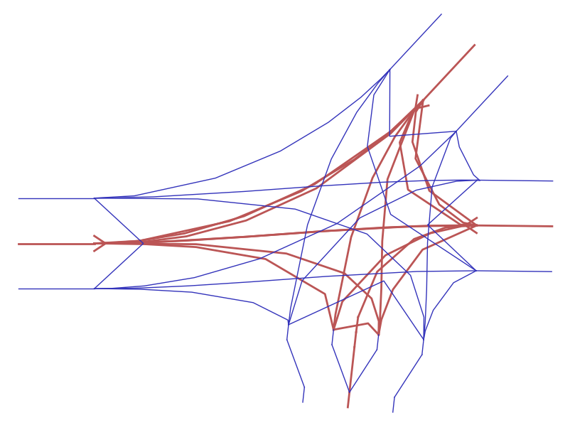
right
left
right
bot
top
left
right
bot

Slide 13
right
left
right
bot
top
left
right
bot

Slide 14
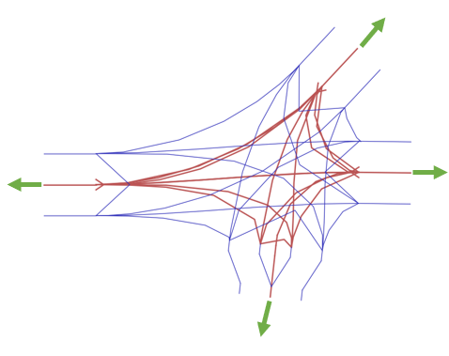
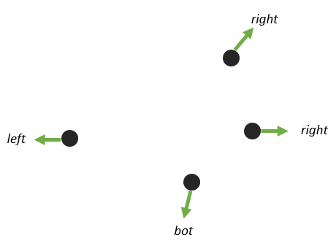
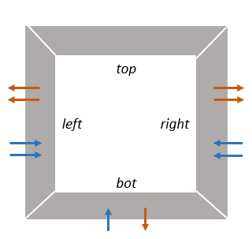
1. Calculate outward heading at each incident point
2. Assign incident roads to one of four direction quadrants
2. Create a Direction Intersection which have number of incoming and outgoing lanes in each direction quadrants

Slide 15
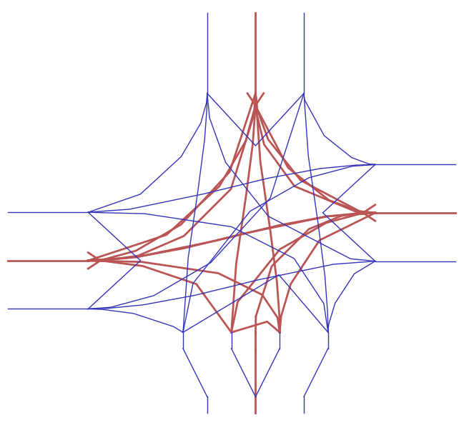
top
right
left
bot
top
left
right
bot

Slide 16
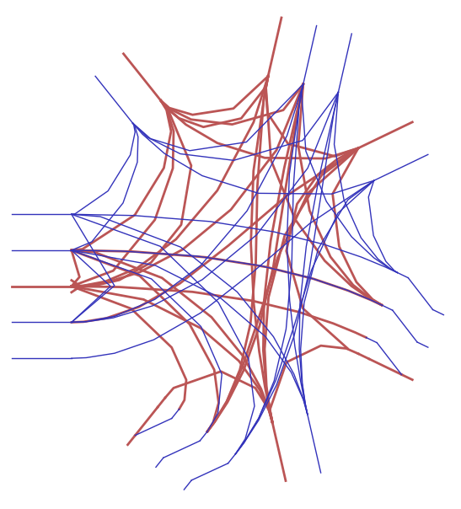
top
top
right
left
right
bot
bot
top
left
right
bot

Slide 17
top
A
top
B
left
right
left
right
bot
bot
????
top
B
top
A
left
right
left
right
bot
bot

Slide 18
8 | 8 | 8 | 8 | 8
8 | 8 | 8 | 8 | 8
8 | 8 | 8 | 8 | 8
8 | 8 | 8 | 8 | 8
8 | 8 | 8 | 8 | 8
8 | 8 | 8 | 8 | 8
8 | 8 | 8 | 8 | 8
8 | 8 | 8 | 8 | 8
7 | 7 | 8 | 8 | 8
 | 7 | 8 | 8 | 8
8 | 8 | 8 | 8 | 8
8 | 8 | 8 | 8 | 8
7 | 7 | 7 | 8 | 8
6 |  | 7 | 8 | 8
 | 6 | 7 | 8 | 8
(a)
(b)
(c)
8 | 8 | 8 | 8 | 8
8 | 8 | 8 | 8 | 8
7 | 6 | 6 | 7 | 8
6 |  |  | 7 | 8
 |  | 5 | 7 | 8
8 | 8 | 8 | 8 | 8
8 | 8 | 8 | 8 | 8
7 | 7 | 7 | 8 | 8
6 |  | 6 | 8 | 8
 |  | 6 | 8 | 8
(f)
(e)
(d)

Slide 19
Control line based generators
Start with some horizontal control lines.
Put points on the lines
Create a graph with the points as vertices with non-overlapping edges. Points in adjacent control lines can connect to each other.
Create intersections at the points

Slide 20
Control line based generators
Reconstructing HD map from OSM, OSM can give us a network. ARGO-Verse HD maps. ML model to convert OSM to HD map?

Slide 21
Control line based generators
For both horizontal and vertical lines, first create points at the intersections and add the edges. Then remove the vertical lines
Apply the same algorithm as before

Slide 22
Control line based generators
For both horizontal and vertical lines, first create points at the intersections and add the edges. Then remove the vertical lines
Apply the same algorithm as before

Slide 23
Hybrid generators
For both horizontal and vertical lines, first create points at the intersections
Place the intersections in available spaces
Find the intersection points between an intersection and the surrounding control lines. Call them orange points
Merge intersection points to previously existing points if necessary. Merged points are purple points.

Slide 24
Another approach
Create control lines by extending incident roads
Categorize lines as horizontal or vertical (or diagonals). Maybe 4 categories would yield better looking maps
Find adjacent control lines

